Slide 1
Remote Online Veterinary Record (ROVR)
Introduction
Updated: 12 September 2013

Slide 2
Purpose
To provide Veterinary Services personnel an overview of the Remote Online Veterinary Record (ROVR) application in order to work towards a smooth deployment and transition
To build awareness and engage the user community early in the deployment process

Slide 3
System Overview
ROVR is an enterprise web-based application for world-wide use to support the United States Army Veterinary Services (VS)
ROVR supports Government Owned Animals (GOA) (including Military Working Dogs [MWD] and equine animals) and Privately Owned Animals (POA)
ROVR has a single-point-of-entry and fully accessible data repository

Slide 4
Core Functionality
Patient/Owner Management
Scheduling/Managing Appointments
Clinical Documentation (SOAP Note)
Forms Generation (e.g. Rabies Certificate, Veterinary Health Certificate, FAVN-OIE Rabies Antibody Test)
Task/Order Management
Invoicing with support for different owner rate plans
Inventory Management
Working Dog Management System (WDMS) Interface
Patient Lists/Registries
Daily/Monthly Financial Reports
Clinical/Administrative Reports

Slide 5
Standard Configuration
ROVR Configuration is Standardized and Approved by DoDVSA:
Owner Categories:
POA
GOA
Stray
Holdover
Contract
Owner Rate Plans:
DHP GOA
Non-DHP GOA
Full Markup
Zero Rate
Owner Organization Types (such as POA, MWD, TSA, Border Patrol, Customs, DEA, Capitol Police, and Unit Mascot)
Standardized Accounting Codes (GLACs)

Slide 6
Standard Configuration
Continued…
Inventory Items (Retail and Supply)
Vaccine Products
Services and Master Service Packages
Laboratory Tests and Radiology Procedures
Medications
Allergies
Interactions:
Drug-Drug Interactions
Drug-Allergy Interactions
Drug-Condition/Problem Interactions
Drug-Species General Interactions
Species, Breeds, Colors, Animal Use
AAHA terms for Assessments/Problems (mapped to SNOMED)
Standard Templates for clinical encounter documentation

Slide 7
Getting Started
ROVR is a secure, web-based application that can only be accessed by an authorized user utilizing a valid Common Access Card (CAC)
Users will be prompted to select their appropriate CAC Certificate and PIN as part of the authentication process
User account management and role assignments will be performed centrally

Slide 8
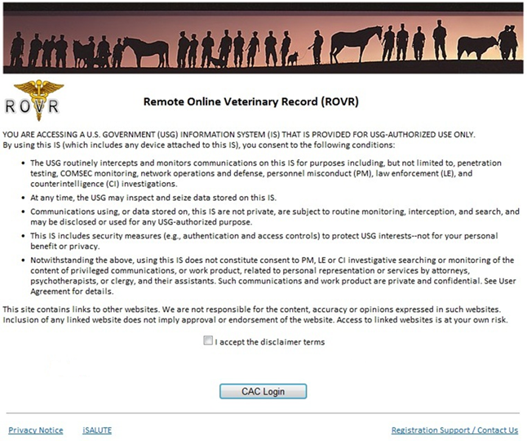
ROVR Login Screen

Slide 9
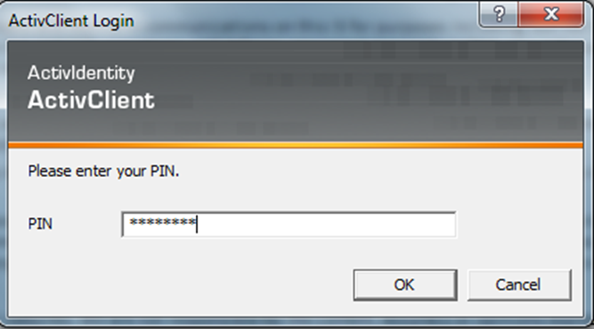
CAC Selection/PIN Screens

Slide 10
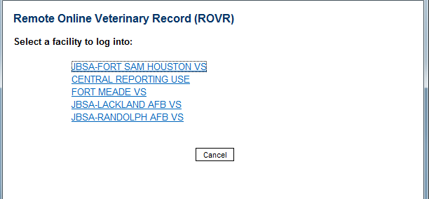
Multi Facility
Primary location will be at the top or first location
All secondary locations will be below the primary location

Slide 11
ROVR Home Page
Left Hand Navigation
Main Menu Bar
Task Management
Appointments

Slide 12
ROVR Home Page
Appointments
Default view is today’s appointments for the user
View appointment schedule for specific Day, Week or Month
Quick access to eNotes to document patient encounters
Task Management
Route and manage patient specific tasks/orders
Orders
Labs
Rads
Referrals
Procedures
Immunizations
Other
Default view is ‘Assigned open items due within 30 days’
Tasks/Orders can be managed from Home Page or within a patient chart

Slide 13
Main Menu Bar
Purpose: Provides quick access to key ROVR functionalities (based on User Roles); it is always accessible
Home – Returns user to their home page
Lookup Patient – Look up patient records
Scheduler – Access the Scheduler screen
Daily Activity – Access the Daily Activity screen
My Appts – Displays the user’s appointments
My Patients - Allows users to create, view, and manage Patient lists and Registries such as the WDMS Registry
Lock – Allows the user to lock their session
Log Off – Allows the user to safely and securely sign out of the application

Slide 14
Left Hand Navigation
Purpose: To provide access to ROVR functionality based on User Roles and Permissions
Displays the links used to access various features/modules
Each user’s Left Hand Navigation options are driven by their assigned “User Roles”
User Roles are primarily tied to VTF staff position (Vet, Vet Tech, Front Desk, Front Desk Mgr)
Two views exist depending on if a patient chart is selected
When a patient chart is selected, the links provide access to patient centric features/modules
When a patient chart is not yet selected, the links provide access to primarily administrative functions (non-patient specific) under headings for Provider Tools, Reports, and Admin.
Under both views, a user can access various blank forms/health certs, guidelines, regulations and other authorized web sites.

Slide 15
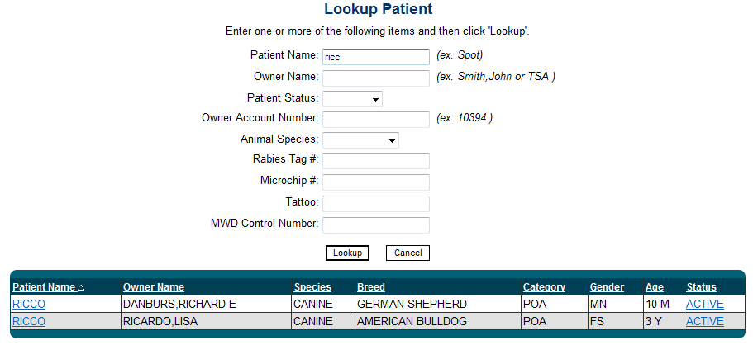
Lookup Patient Screen
Provides several ways to search for a patient including Patient Name, Owner Name, Owner Account Number, or Tattoo.
Select a Patient’s Name to open the patient chart; system displays the Patient Summary screen (see next slide)

Slide 16
Patient Summary Screen
Main patient demographic area; always accessible when in a patient chart
Patient-centric navigation links

Slide 17
Patient Summary Screen
Provides a quick look at the patient’s allergies as well as “summary” items for the patient:
Appointments
Medications
Hospitalizations
Problems List
Surgeries/Significant Interventions
If there are more than six entries in these sections you will see a “More” link. Clicking the “More” link or clicking the section name (ex. “Medications”) will take users to an expanded view for that section.
General Chart Information is also displayed

Slide 18
Prevention Screen
Prevention screen for a GOA patient with Special Handling Instructions indicated next to Patient Name in demographic area

Slide 19
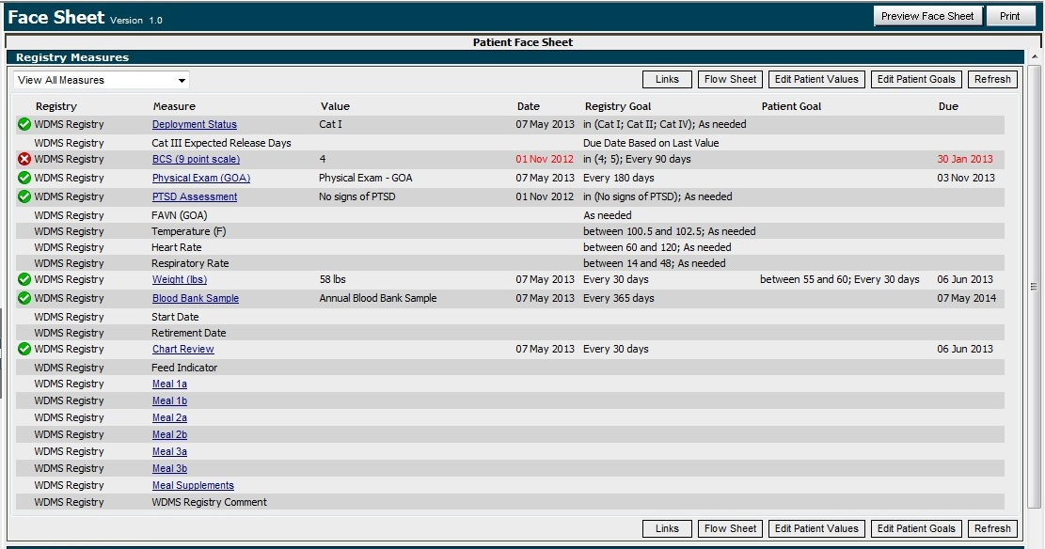
Patient Registries
WDMS Registry to manage and track specific measures for MWDs
Example Measures: Shows current Deployment Status for animal and indication of expected release date if Cat III. Shows when Physical Exam and Chart Review were last done and when they are due next. Shows ideal weight range for this animal and if they are meeting that goal.

Slide 20
Scheduling Functionality
Scheduling and Managing Appointments
Initial Scheduler screen defaults to user’s Provider Team Appointments for Today
Select Provider(s)/Room(s) and Date to view schedule and create/update appointments
Up to 6 providers/rooms can be displayed on screen
Search for Appointments by Patient or Owner Name and Date Range
Search for Available Time slots
Supports drag and drop to change appt time/provider
Mouse over appointment displays patient/appointment details; right click brings user to context menu to update appointment status
Supports patient as well as non-patient appointments for non-work/clinic time such as for a meeting, TDY, lunch, etc.

Slide 21
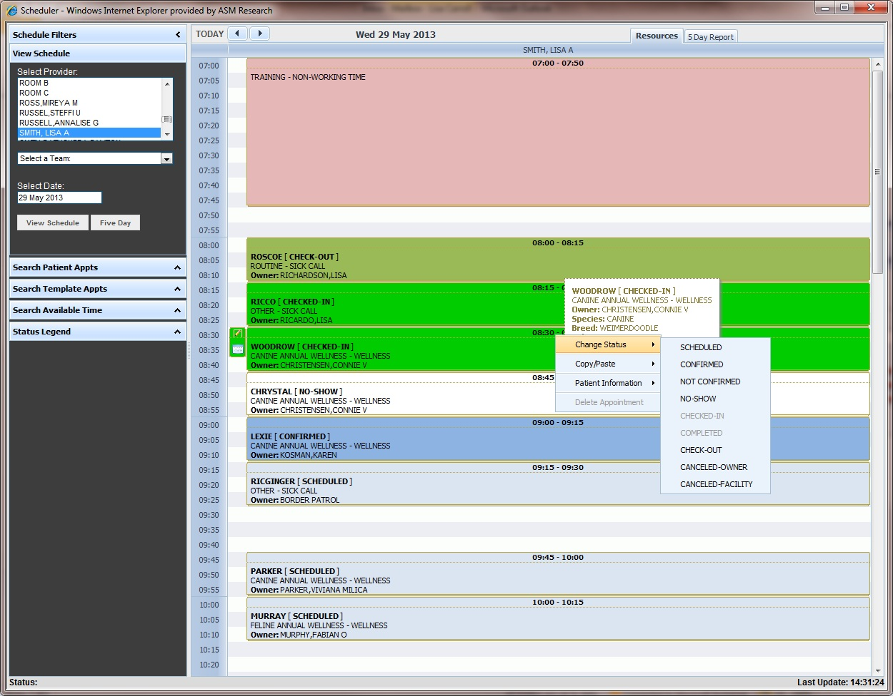
Scheduler Screen
Mouse over appt to see details.
Right click appt to change status.

Slide 22
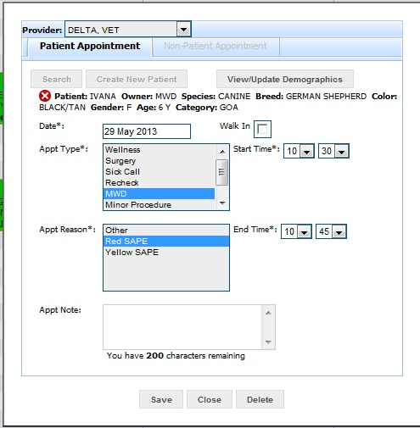
Create/Edit Appointments
Double clicking on Scheduler screen for a specific time will open the Create/Edit Appointment window
User can search for the patient or create a new one
Once a patient is selected, any alerts for the patient will show with the status icon and mouse over text for the details
Selection of the Appt Type and Reason sets default time range in increments of 5 minutes; user can override as needed

Slide 23
Daily Activity Workflow
Dashboard to Manage Daily Activity such as:
Checking In and Checking Out Patients
Accessing a Patient Chart
Updating Patient/Owner Demographic Information
Displaying Pending Charges and Account History
Processing a Counter Sale
Searching for a specific Owner record to access Account History and process a payment/refund
Providing a visual queue of:
Patient appointments that need to be completed
Pending charges that need to be posted

Slide 24
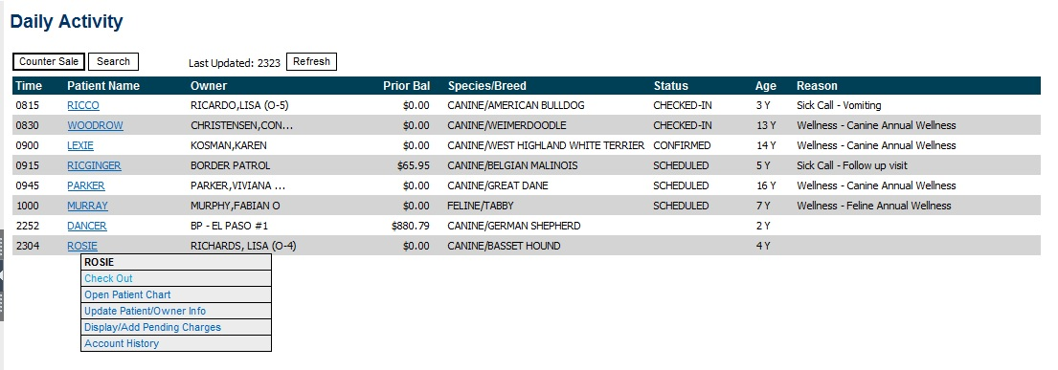
Daily Activity Screen
Daily Activity screen provides a snapshot of a VTFs appointments that are in progress. Once a patient is checked-out and appointment status is marked ‘Completed’, they are no longer displayed on Daily Activity screen. Patient’s with recent pending charges are also shown to help ensure posting is performed.

Slide 25
Clinical Documentation
Encounter Notes (eNotes):
eNotes are ROVR’s clinical documentation tool
eNotes can be created, saved, signed, co-signed, forwarded, printed, and viewed
eNotes can be created with or without an appointment
eNote templates have been defined for a variety of clinical encounters (Sick Call, Wellness, SAPE, etc.) with appropriate sections and data elements
Information entered in one eNote can be ‘carried forward’ into the next eNote and then changed as needed to help reduce data entry time

Slide 26
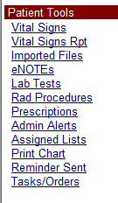
Accessing eNotes
A patient’s list of eNOTEs can be accessed from the left hand navigation links once the patient’s chart is selected
A list of previous notes for a patient can also be easily viewed from within the current eNote being documented
Notes associated with an appointment can also be accessed by selecting the appointment on the provider’s or patient’s appointment list
eNOTEs Link

Slide 27
eNote Templates
DoDVSA approved eNote Templates are provided with the appropriate sections and options to document a variety of clinical encounters
These are currently the templates that display for an 10 year old patient:

Slide 28
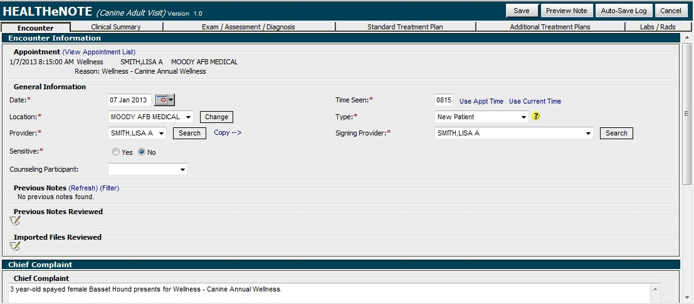
Wellness eNote
Encounter Tab (using the Canine Adult Visit template) displays Appointment information including the Chief Complaint populated from what was entered in the Scheduler
Appointment Information
Quick access to previous notes for patient
Chief Complaint

Slide 29
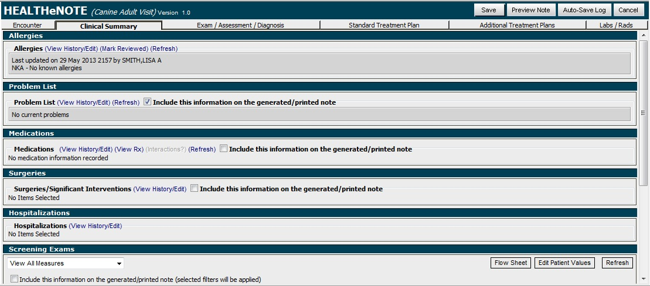
Wellness eNote
Clinical Summary Tab allows user to document Allergies, Problem List, Medications, Surgeries, Hospitalizations, Screening Exams and Registry Measures (for example the WDMS Registry for GOAs)

Slide 30
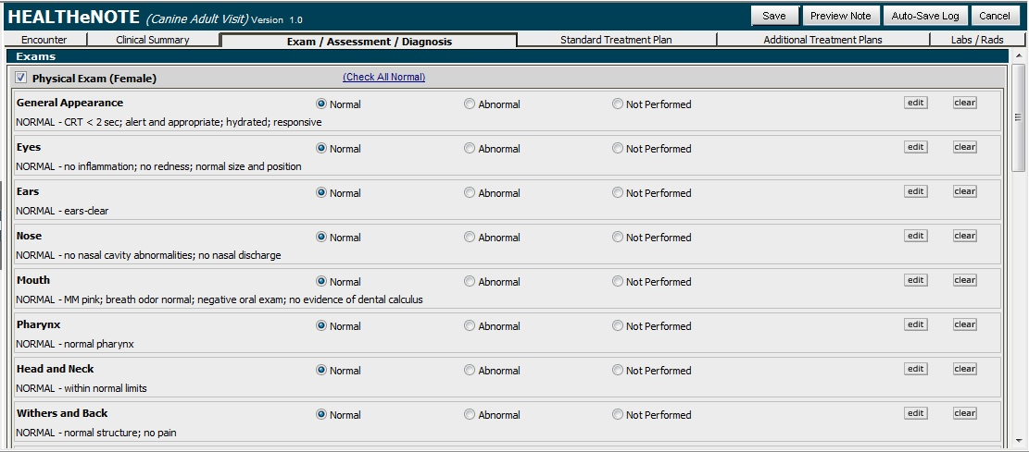
Wellness eNote
Exam/Assessment/Diagnosis Tab allows user to document the Physical Exam, Assessment and Problem List information
Quickly allows user to document normal exam by selecting Check All Normal

Slide 31
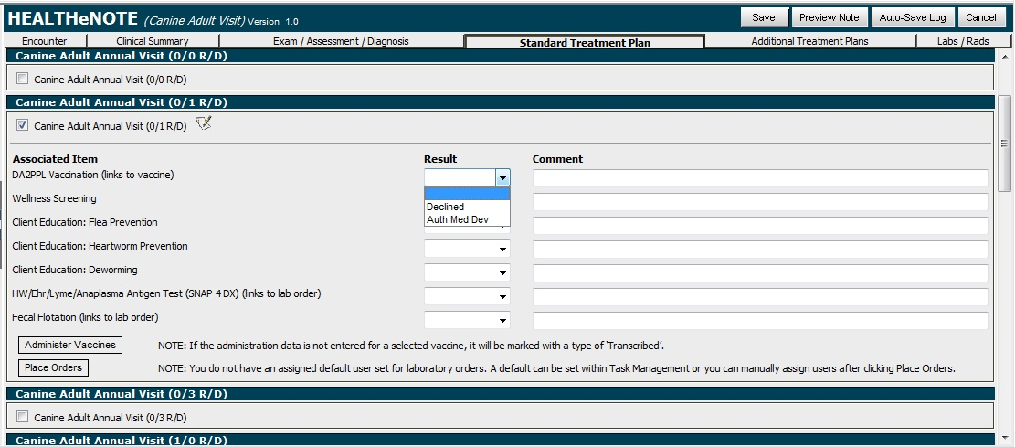
Wellness eNote
Standard Treatment Plan Tab allows user to select Master Service Packages and document the Administering of Vaccines and Medications
Master Service items can be Declined or documented as Authorized Medical Deviation; Declined items will cause the discount to be removed.

Slide 32
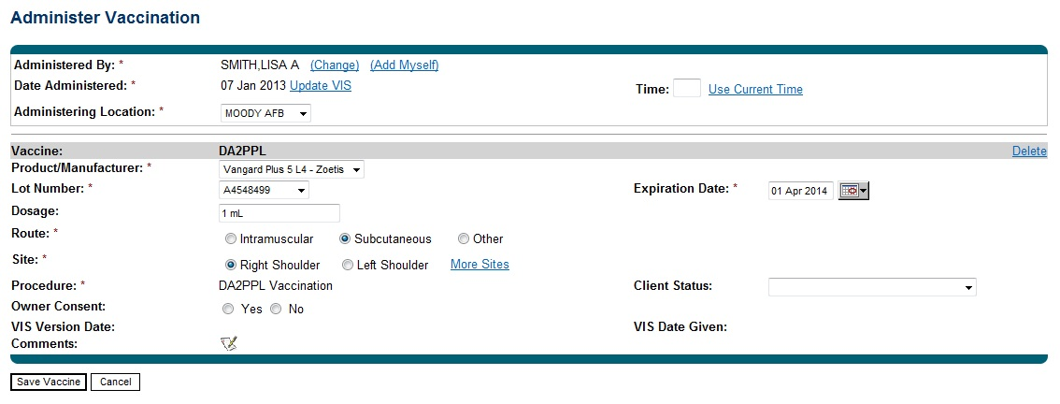
Administer Vaccinations
Administer Vaccination screen populates with default information for recently used lot number(s) and dosage/route/site based on the selected vaccine product. User can change the defaulted information as needed.

Slide 33
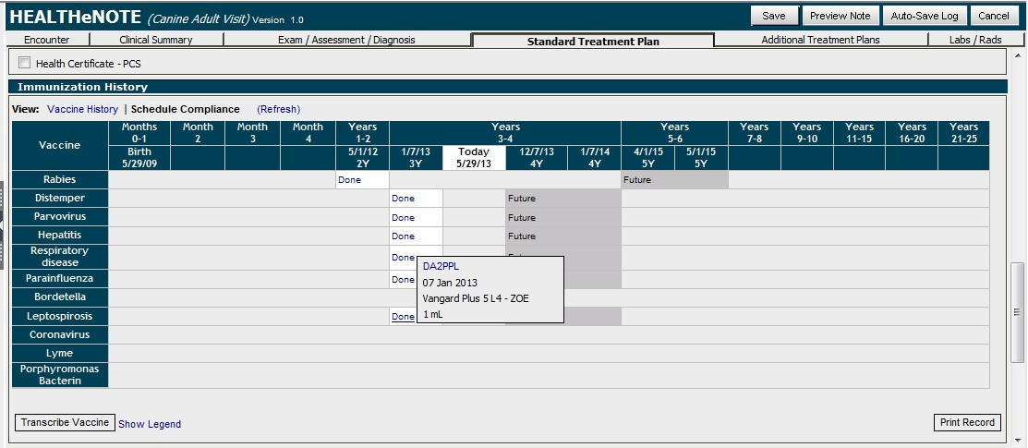
Immunization History
Immunization History section displays a vaccine schedule with compliance based on patient’s age and species. Mouse over ‘Done’ items to display the vaccination details; mouse over ‘Future’, ‘Due’ and ‘Past Due’ items to view justification details for the vaccine.

Slide 34
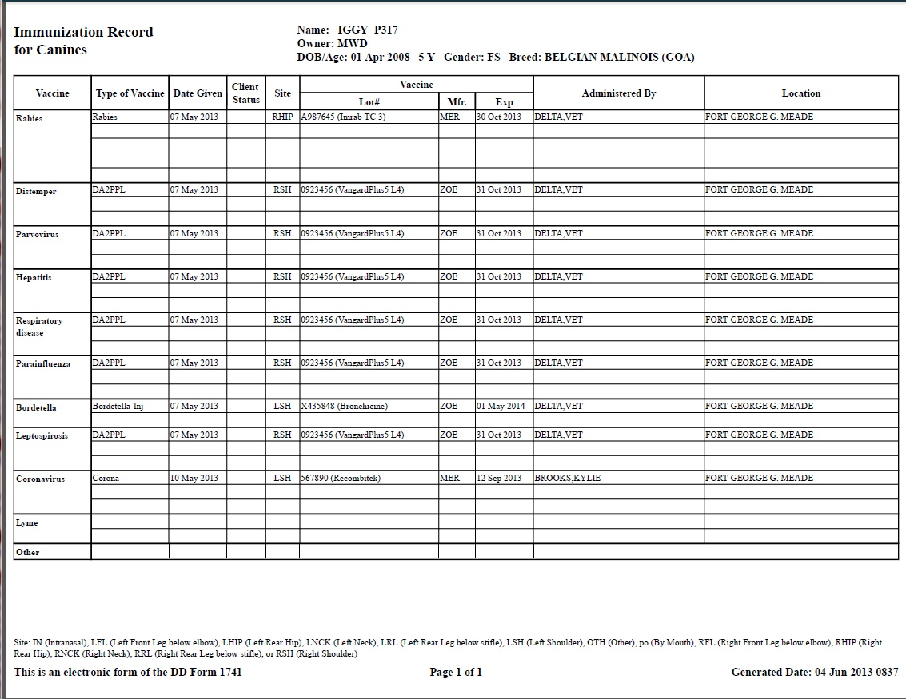
Immunization Record

Slide 35
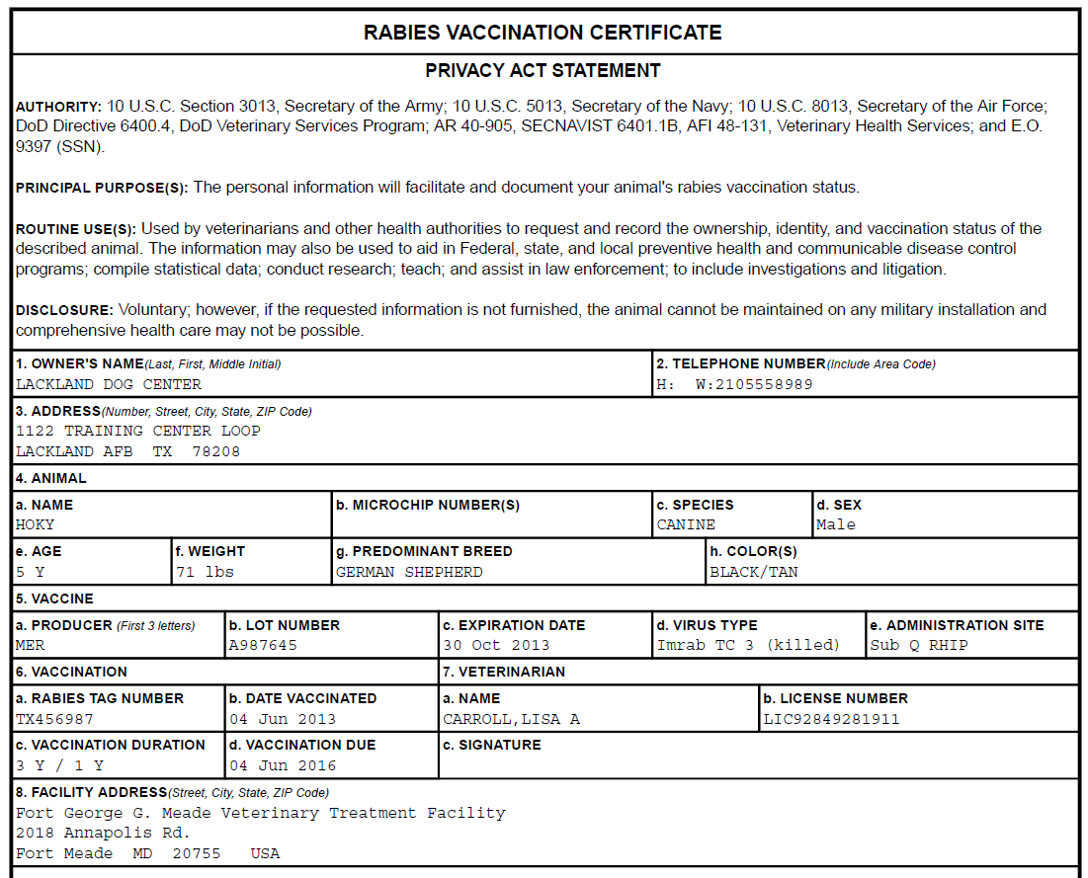
Rabies Certificate

Slide 36
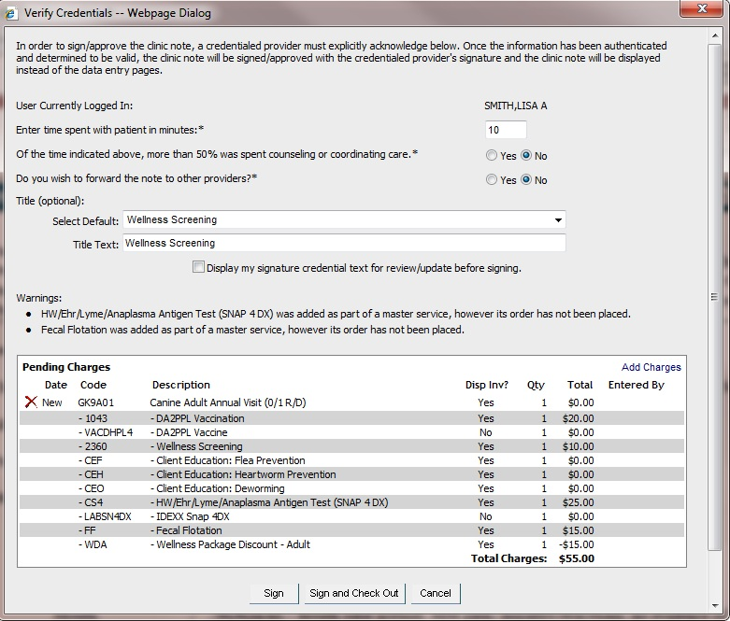
Sign eNote
Signing the eNote allows user to view Pending Charges, document amount of time spent with patient, and select a Title for the note to display on the Patient’s eNote list
User can click Sign and Check Out option to signal Front Desk the patient is ready to be checked out

Slide 37
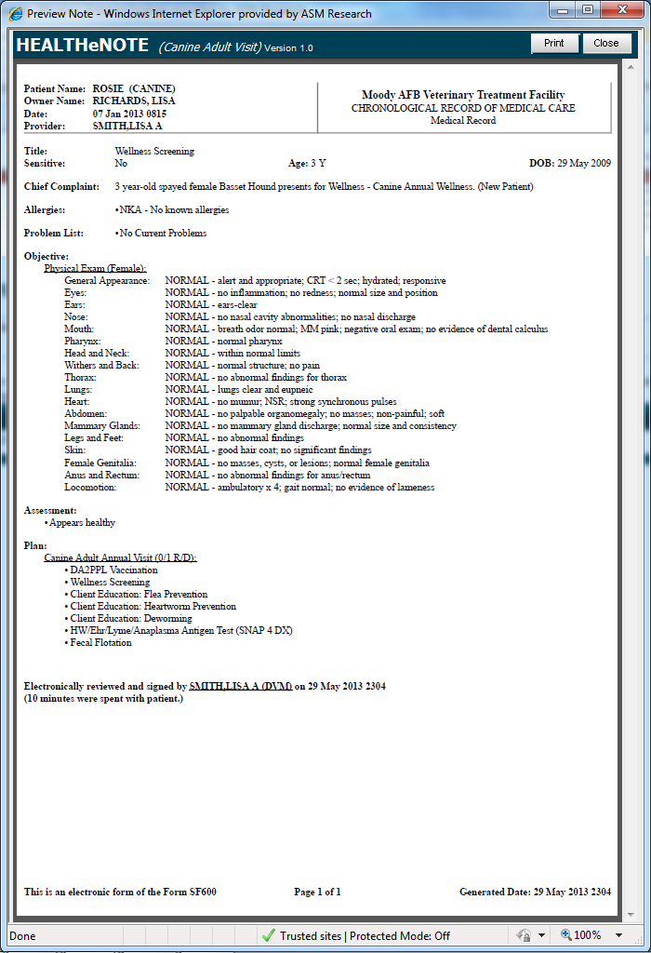
Generated/Printed eNote
The generated/ printed eNote pulls the information entered throughout the tab pages and puts it into SOAP Format
The footer indicates it is an electronic version of the SF600

Slide 38
Invoicing Overview
Supports 4 standard Rate Plans:
DHP GOA
Non-DHP GOA
Full Markup
Zero Rate
Supports DoDVSA approved Minimum ($3.50), Maximum ($20), and Percent Markup (35%) for POAs on inventory items
Allows users to post charges and generate Invoices, Receipts, and Statements
Allows users to process payments and issue refunds
Allows authorized users to enter advanced financial transactions to handle bad debt write-off, returned check fee, vendor refunds, transfer in/out of accounts receivable, adjust a credit balance, etc.
Supports the Daily/Monthly Financial Reports:
Deposit Slip
Transaction Summary
Accounts Receivable
Account Summary

Slide 39
Invoice Pricing Overview
Owners will be associated with an Organization Type to determine the appropriate Rate Plan and Owner Category
Organization Type (this list will be configured behind the scenes) | Owner Category | Rate Plan
Border Patrol | GOA | NON-DHP GOA
Capitol Police | GOA | NON-DHP GOA
Customs | GOA | NON-DHP GOA
DEA | GOA | NON-DHP GOA
Holdover | HOLDOVER | NON-DHP GOA
Military Equine (DHP) | GOA | DHP GOA
Military Equine (Non-DHP) | GOA | NON-DHP GOA
Military Working Dog Training Center | GOA | ZERO RATE
MWD | GOA | DHP GOA
MWR Animals | GOA | NON-DHP GOA
Other Contract | CONTRACT | NON-DHP GOA
Other DHP GOA | GOA | DHP GOA
Other Non-DHP GOA | GOA | NON-DHP GOA
Other Zero Rate GOA | GOA | ZERO RATE
Pentagon Force Protection Agency | GOA | DHP GOA
POA | POA | FULL-MARKUP
Secret Service | GOA | DHP GOA
Stray | STRAY | DHP GOA
TSA | GOA | NON-DHP GOA
Unit Mascot | GOA | DHP GOA

Slide 40
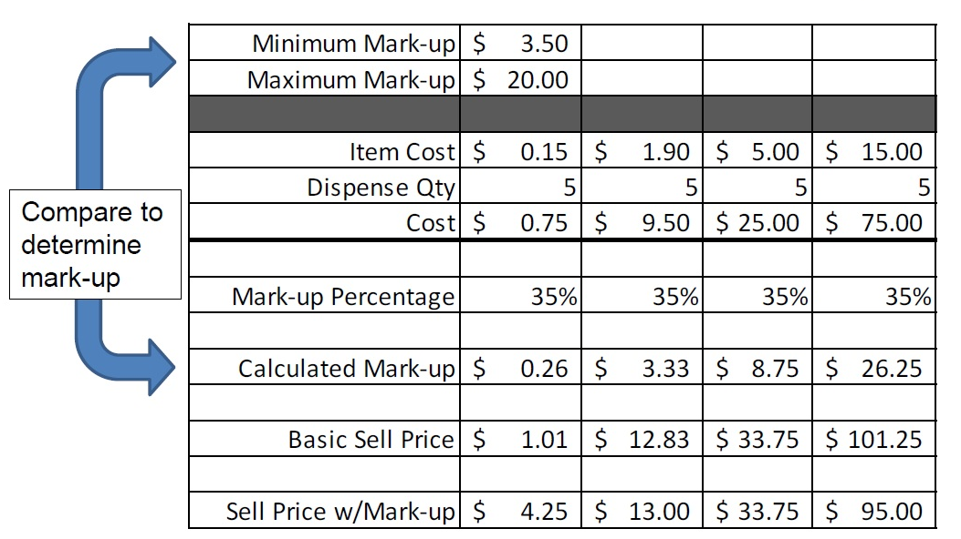
Invoice Pricing Overview
Minimum, Maximum and Percent Mark-up are applied to Inventory items based on Inventory Category and Rate Plan (currently configured just for POAs)

Slide 41
Invoicing Process – Check Out
Daily Activity > Check Out Patient allows user to:
Review Pending Charges
User Fee will automatically be added for POAs (one user fee is added regardless of the number of patients being checked-out)
Add Charges (ex. Counter Sale) prior to Posting
View Account History and Transaction Detail
Return Items
Post Charges for GOAs and Post and Invoice for POAs
Accept Payments/Issue Refund
Print Invoice and Receipts

Slide 42
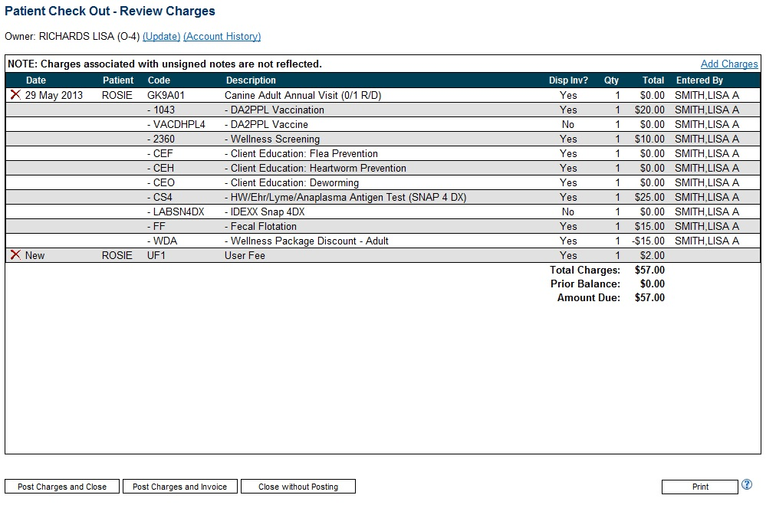
Review Charges

Slide 43
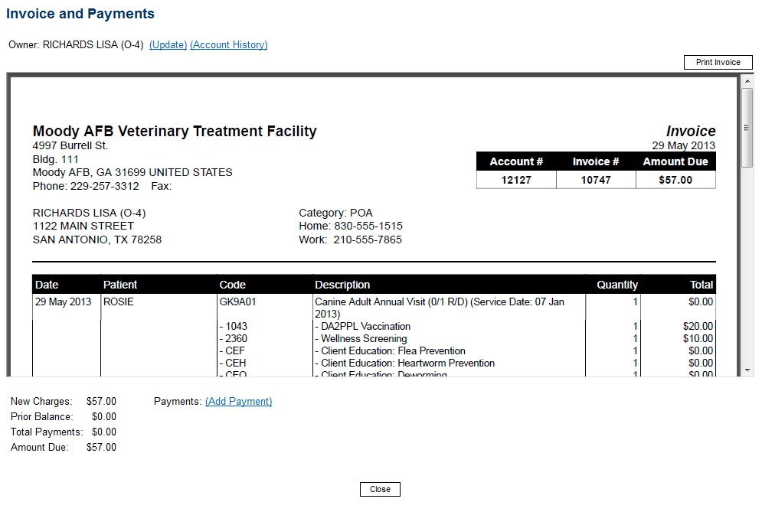
Invoice and Payments Screen
Once the Post Charges and Invoice button is clicked, the system displays the Invoice and Payments screen. User can review/print the invoice and then select add payment.

Slide 44
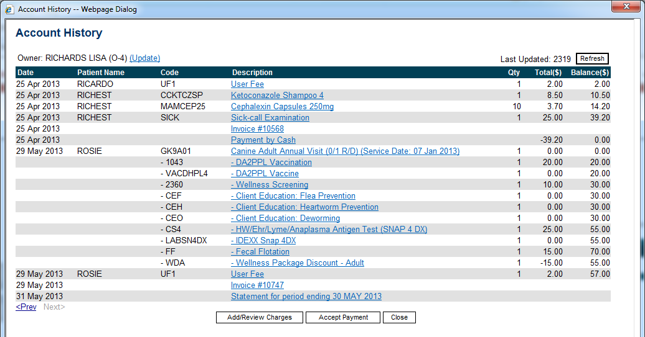
Account History Screen
If payment is not entered, the Account History screen reflects a balance due.
Clicking on the description for an item displays the details for that entry whether it be the transaction details or displaying the generated invoice/statement.

Slide 45
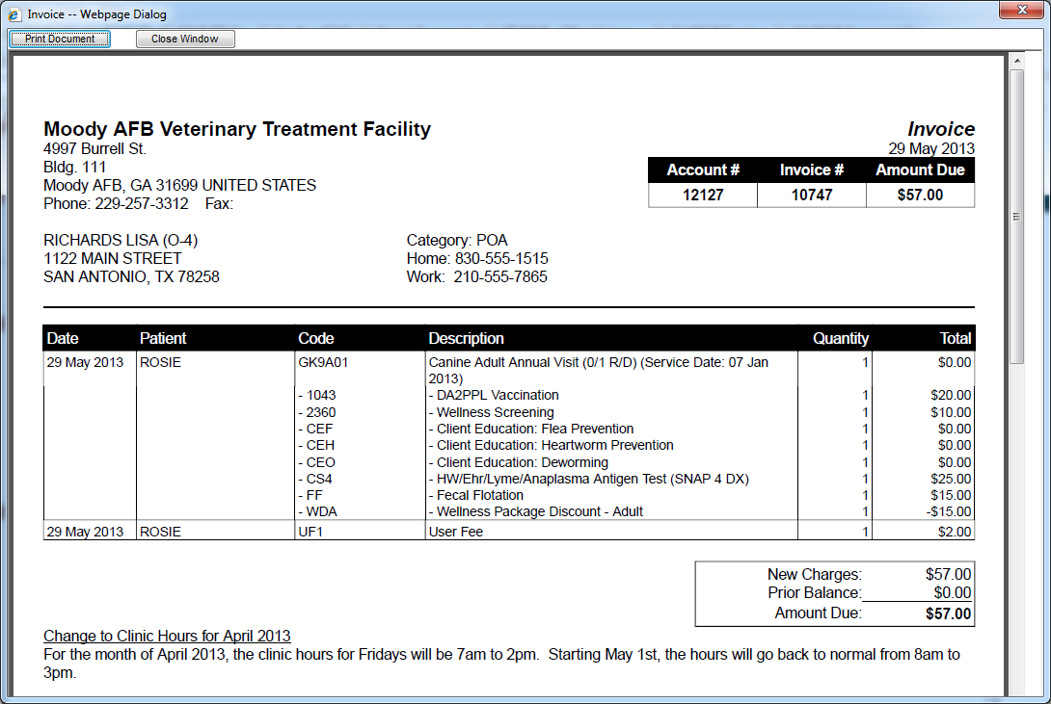
Invoice Sample
Each invoice can be viewed from the Account History screen
Each VTF can configure notices to display on their invoices

Slide 46
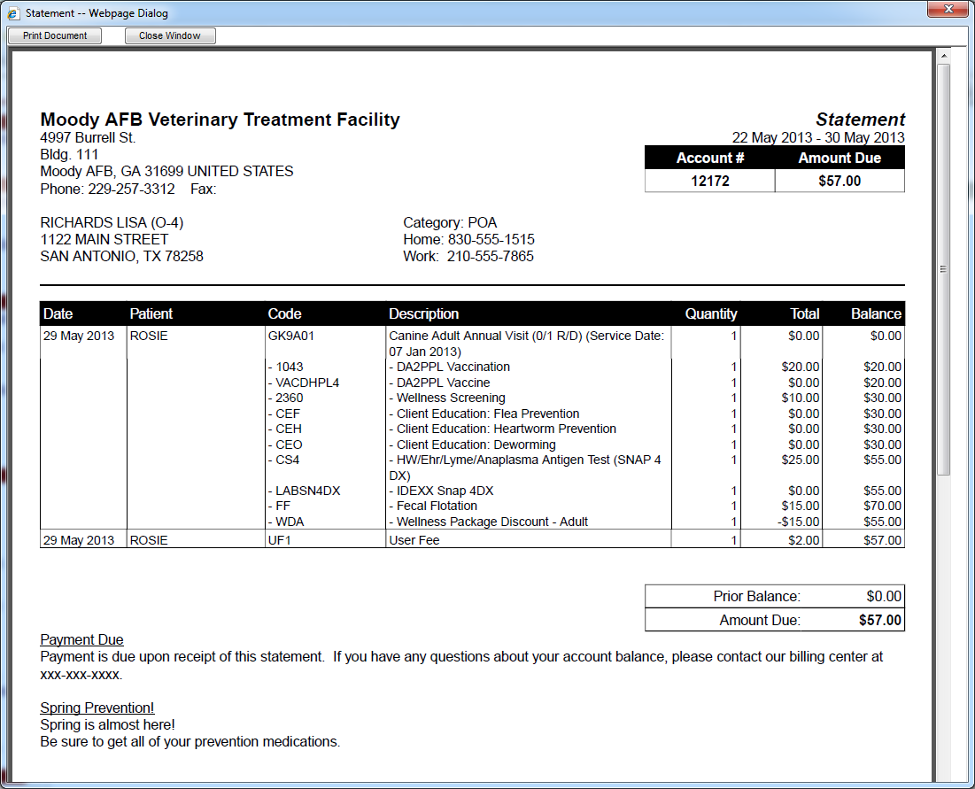
Statement Sample
The Account History screen showed a Statement had been generated since owner has a balance.
Each VTF can configure one or more notices to display on their statements

Slide 47
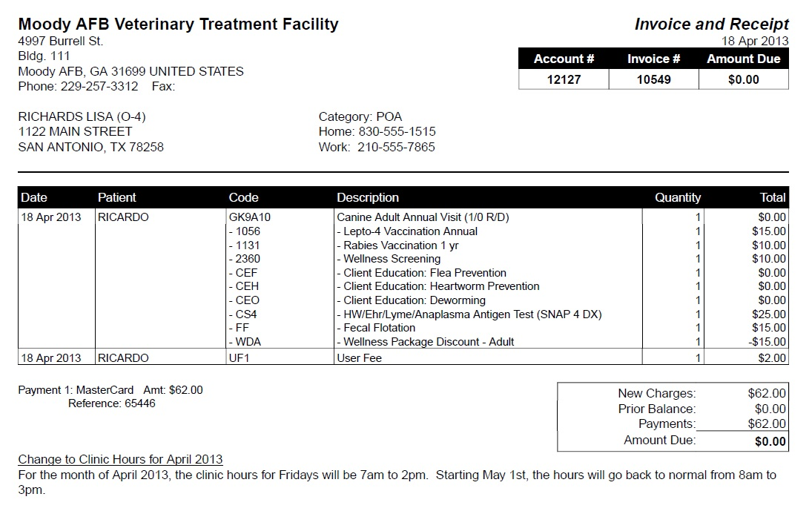
Invoice and Receipt Sample
Payment information is displayed on the Invoice and Receipt; this example is where payment was made at time of invoice

Slide 48
Inventory Management
Inventory Management is supported at the Enterprise Level and VTF Level based on User Role
Enterprise Inventory Management allows Admin users to add new items and ‘Unauthorize’ inventory items as needed (ex. Product recall or formulary changes)
VTF Inventory Management allows users to:
Flag inventory items as ‘Inactive’ based on site needs
Edit, Adjust, and Receive Inventory items with Cost and Quantity information
Perform Inventory Reconciliation process
Inventory dispense/usage adjustments to qty on hand occur automatically for ‘tracked’ inventory items

Slide 49
Inventory Management
Inventory Administration screen at VTF level displays items by Inventory Category for Retail/Supply items and allows user to search by ID, Description or Synonym
List shows cost (either rolling average cost or last unit cost), qty on hand, and qty on reserve (for Rx refills not yet picked up)

Slide 50
Patient Merge
The Patient Merge feature allows users the ability to merge two patient records into a single record. This feature should only be used to eliminate those patient records that were created by mistake for the same patient.
Merge this record to the record below
Keep this record

Slide 51
Patient Merge
Top record will be merged into the bottom record
Scheduled Merge

Slide 52
Patient Transfer
The Patient Transfer feature allows users at the Veterinarian Treatment Facility (VTF) to manage active patients transferring or moving between facilities.
A key ROVR feature is there is one patient record that is accessible anywhere in the world
There are two different types of patient transfers, a temporary transfer and a permanent transfer.

Slide 53
Patient Transfer
Grant temporary access to a patient record
Initiate a permanent transfer
“All” means the owner has multiple animals

Slide 54
Send Reminders
Send reminder’s allows users to configure a set of filters and criteria by which a list of email reminders will be generated for patients who are coming due or over due for vaccines and screening exams.
This is a two step process for generating email reminders. To start the process the user will select the desired filters and click the Schedule Email Reminders button. This will schedule a process to run at night to create the applicable reminders. The following day, users will need to return to the Send Reminders page to verify the reminders were successfully created. To actually send the email reminder, users must click the status hyperlink and then click the Send Email(s) button.

Slide 55
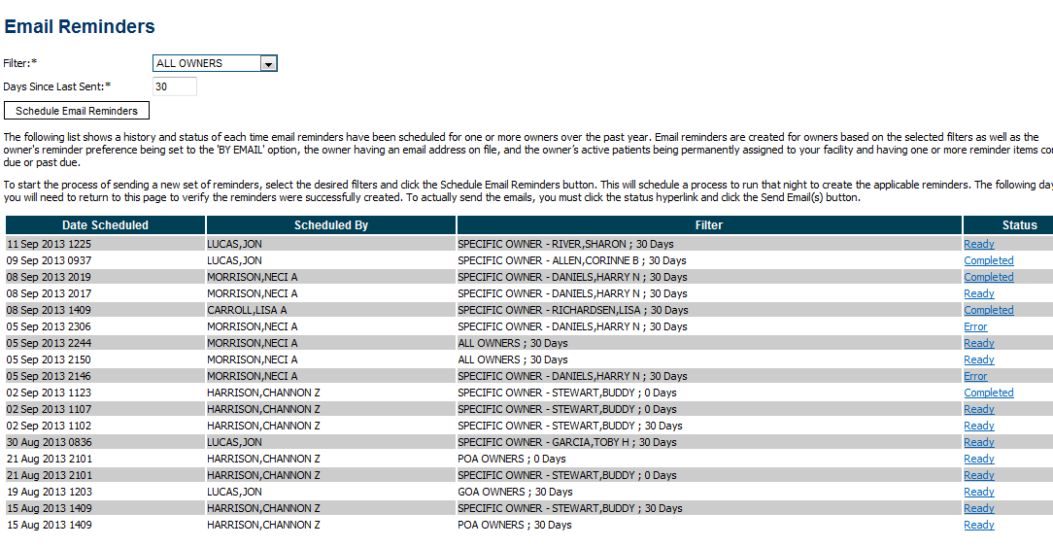
Send Reminders
Filters for setting up email reminders
Status

Slide 56
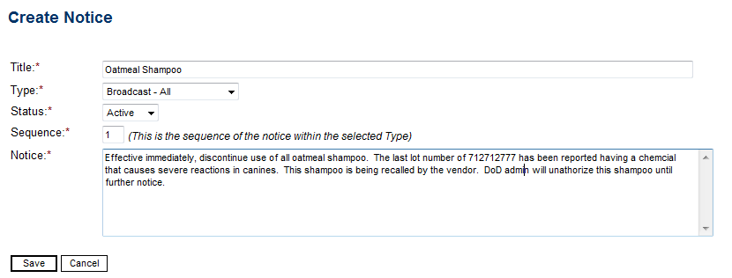
Broadcast Alerts
Broadcast Alert messages are used to send alert notices to clinical, administrative, OIC/NCOIC, and all personnel within the VTF.
Notice message

Slide 57
Training Overview
ROVR Instructor Led Training:
Four (4) days of training covering all functionality broken down into these modules:
Basic Admin Modules
Basic Clinical Modules
Basic Admin Clinical Modules
Special Modules
Training will be held in a classroom environment with instruction and class exercise (hand’s on) time built into the agenda

